Slide 1
From the Quaver Music Home Page,
select “Student Interactives”.

Slide 2
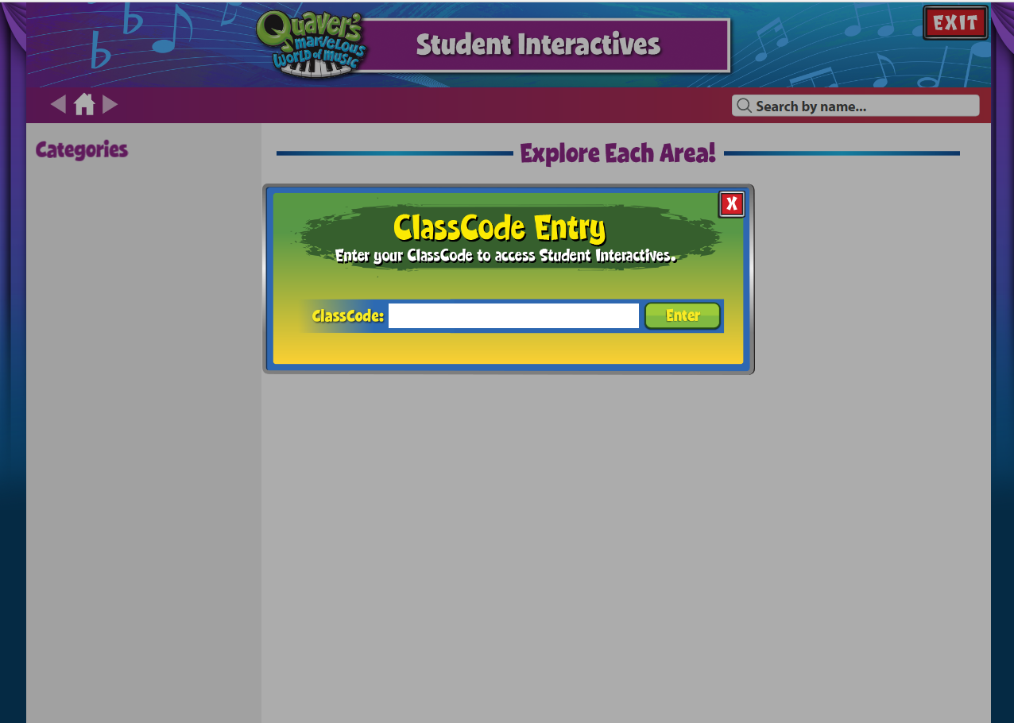
Enter the class code
HOME20

Slide 3
Students have a
variety of categories to explore.

